Slide 1
Fragments
Advanced Android Development
Lesson 1

Slide 2

1.1 Fragments
A reusable UI component with its own lifecycle

Slide 3
Contents
Understanding the Fragment class
Creating a Fragment
Using a layout for a Fragment
Adding a Fragment to an Activity

Slide 4
Understanding the Fragment class

Slide 5
Fragment class
Contains a portion of the UI and its behavior
Has its own lifecycle states (like an Activity)
Reusable—share across multiple activities
Each Fragment instance exclusively tied to host Activity
Fragment code defines layout and behavior
Represents sections of a UI for different layouts

Slide 6
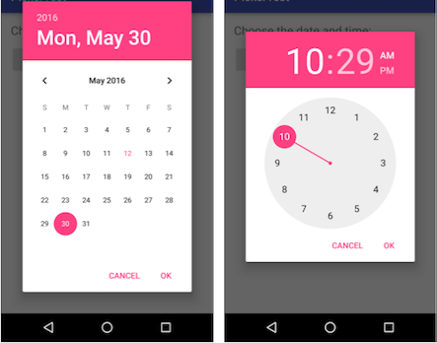
Example: Pickers use DialogFragment
Date and time pickers: Extend DialogFragment (Fragment subclass)

Slide 7
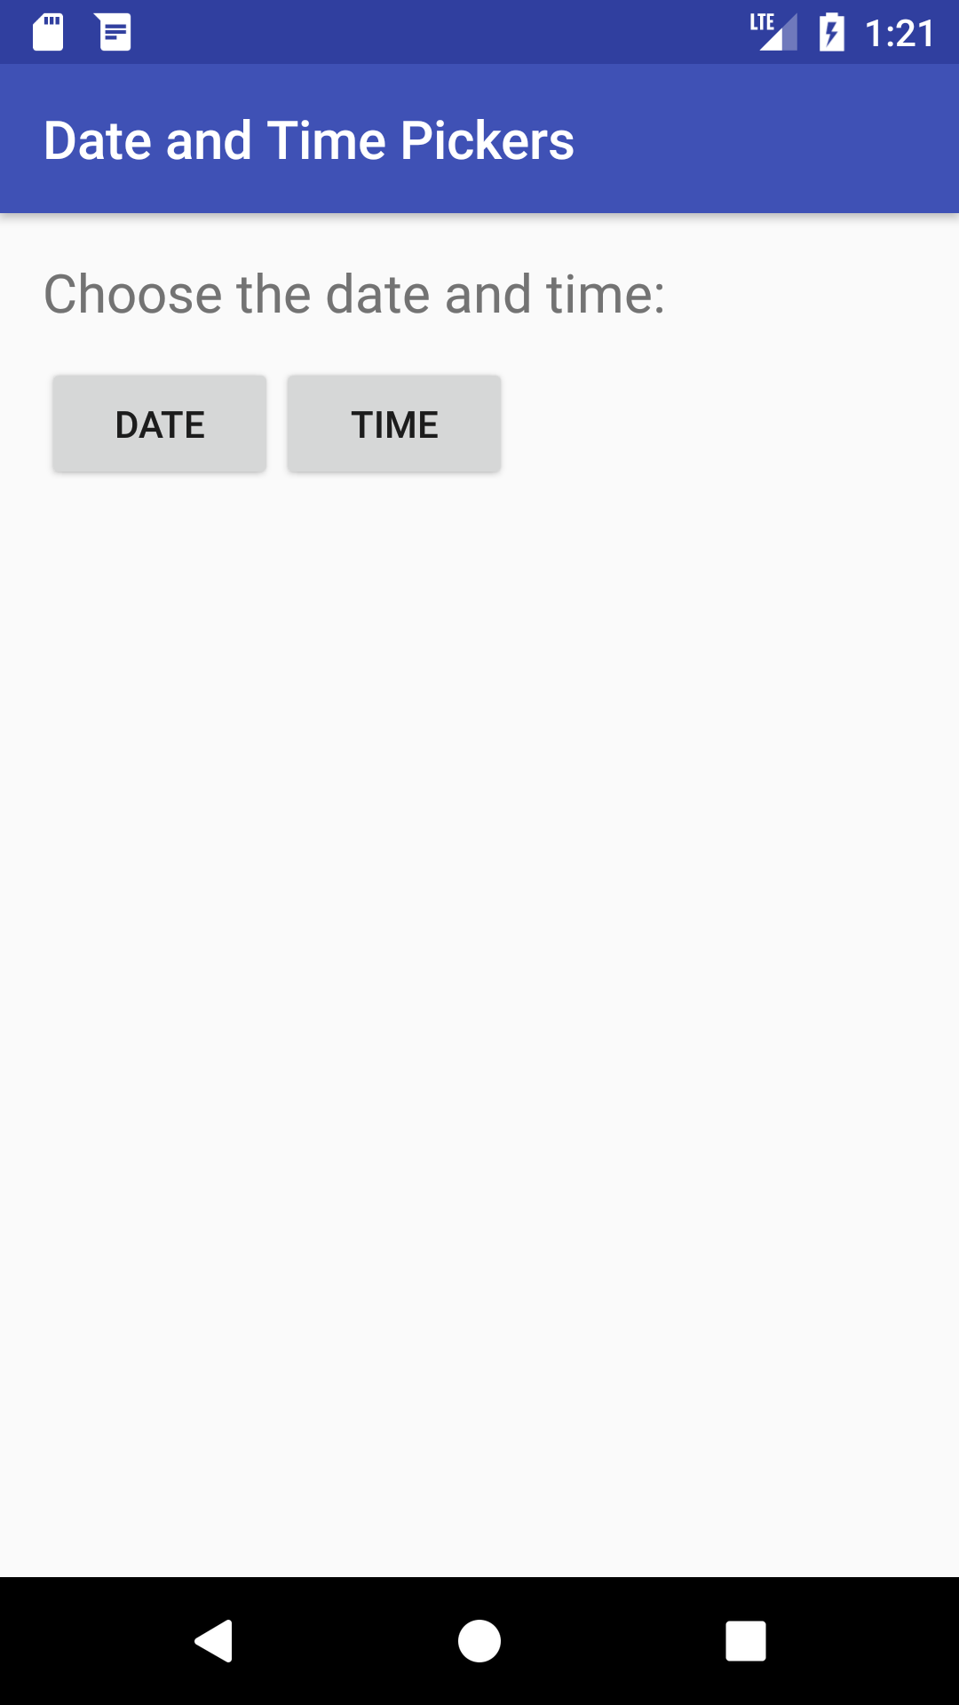
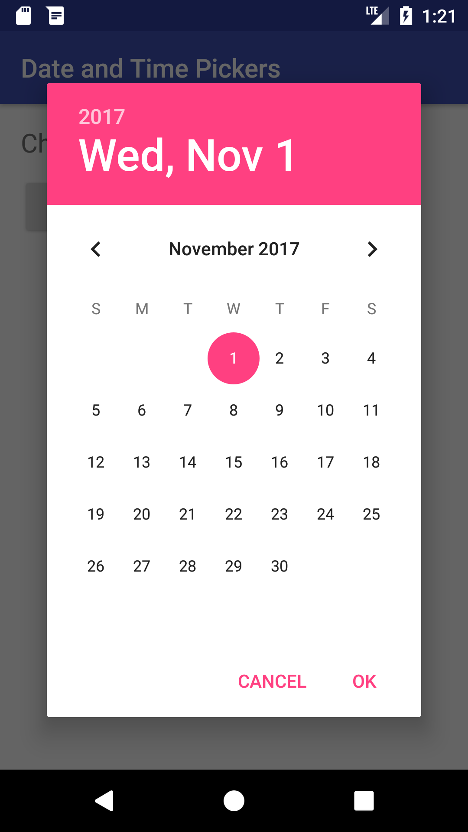
DialogFragment hosted by Activity
1
2
Activity before adding date picker fragment
Date picker fragment appears on top of Activity

Slide 8
Add a Fragment to an Activity
Static part of UI (in Activity layout):
on screen during entire Activity lifecycle
Dynamic part of UI:
added and removed while Activity is running

Slide 9
Benefits of using fragments
Reuse a Fragment in more than one Activity
Add or remove dynamically as needed
Integrate a mini-UI within an Activity
Retain data instances after a configuration change
Represent sections of a layout for different screen sizes

Slide 10
Steps to using a fragment
Create a subclass of Fragment
Create a layout for the Fragment
Add Fragment to a host Activity
Statically in layout
Dynamically using fragment transactions

Slide 11
Creating a Fragment

Slide 12
Add new Fragment in Android Studio
Expand app > java in project and select package name
Choose File > New > Fragment > Fragment (Blank)
Check the Create layout XML option for layout
Other options:
Include fragment factory methods to include a newInstance() method to instantiate the Fragment
Include interface callbacks to define an interface with callbacks

Slide 13
New Fragment
public class SimpleFragment extends Fragment {
public SimpleFragment() {
// Required empty public constructor
}
...
}

Slide 14
Extend the Fragment class
Extend Fragment class
public class SimpleFragment extends Fragment
Extend specific Fragment subclass:
DialogFragment: Floating dialog (examples: date and time pickers)
ListFragment: List of items managed by adapter
PreferenceFragment: Hierarchy of Preference objects (useful for Settings)

Slide 15
Using a layout for a Fragment

Slide 16
Create a layout for a Fragment
Create layout XML option adds XML layout
Fragment callback onCreateView() creates View
Override this to inflate the Fragment layout
Return View: root of Fragment layout

Slide 17
Inflate the layout for the Fragment (1)
@Override
public View onCreateView(LayoutInflater inflater,
ViewGroup container, Bundle savedInstanceState) {
// Inflate the fragment layout and return it as root view.
return inflater.inflate(R.layout.fragment_simple,
container, false);
}

Slide 18
Inflate the layout for the Fragment (2)
Fragment layout is inserted into container ViewGroup in Activity layout
LayoutInflater inflates layout and returns View layout root to Activity
Bundle savedInstanceState saves previous Fragment instance

Slide 19
Inflate the layout for the Fragment (3)
return inflater.inflate(R.layout.fragment_simple, container, false);
Resource ID of layout (R.layout.fragment_simple)
ViewGroup to be parent of inflated layout (container)
Boolean: Whether layout should be attached to parent
Should be false
If adding Fragment in code, don't pass true (creates a redundant ViewGroup)

Slide 20
Adding a Fragment to an Activity

Slide 21
Add a Fragment to an Activity
Add statically in Activity layout, visible for entire Activity lifecycle
Add (or remove) dynamically as needed during Activity lifecycle using Fragment transactions

Slide 22
Add a Fragment statically
Declare Fragment inside Activity layout (activity_main.xml) using <fragment> tag
Specify layout properties for the Fragment as if it were a View

Slide 23
Static Fragment example
Adding SimpleFragment to Activity layout:
<fragment android:name="com.example.appname.SimpleFragment"
android:id="@+id/simple_fragment"
android:layout_weight="2"
android:layout_width="0dp"
android:layout_height="match_parent" />

Slide 24
Add a Fragment dynamically
Specify ViewGroup for Fragment in layout
Instantiate the Fragment in Activity
Instantiate FragmentManager
Use getSupportFragmentManager() for compatibility
Use Fragment transactions

Slide 25
Specify a ViewGroup for the Fragment
Specify ViewGroup to place Fragment (such as FrameLayout):
<FrameLayout
android:id="@+id/fragment_container"
android:name="SimpleFragment"
tools:layout="@layout/fragment_simple"
... />

Slide 26
Instantiate the Fragment
Create newInstance() factory method in Fragment:
public static SimpleFragment newInstance() {
return new SimpleFragment();
}
In Activity, instantiate Fragment by calling newInstance():
SimpleFragment fragment = SimpleFragment.newInstance();

Slide 27
Instantiate FragmentManager
In Activity, get instance of FragmentManager with getSupportFragmentManager():
FragmentManager fragmentManager = getSupportFragmentManager();
Use the Support Library version—getSupportFragmentManager() rather than getFragmentManager()—for compatibility with earlier Android versions

Slide 28
Use Fragment transactions
Fragment operations are wrapped into a transaction:
Start transaction with beginTransaction()
Do all Fragment operations (add, remove, etc.)
End transaction with commit()

Slide 29
Fragment transaction operations
Add a Fragment using add()
Remove a Fragment using remove()
Replace a Fragment with another using replace()
Hide and show a Fragment using hide() and show()
Add Fragment transaction to back stack using addToBackStack(null)

Slide 30
Fragment transaction example (1)
FragmentTransaction fragmentTransaction =
fragmentManager.beginTransaction();
fragmentTransaction
.add(R.id.fragment_container, fragment)
.addToBackStack(null)
.commit();

Slide 31
Fragment transaction example (2)
In the code on the previous slide:
add() arguments:
The ViewGroup (fragment_container)
The fragment to add
addToBackStack(null):
Add transaction to back stack of Fragment transactions
Back stack managed by the Activity
User can press Back button to return to previous Fragment state

Slide 32
Fragment transaction example (3)
Removing a Fragment:
SimpleFragment fragment = (SimpleFragment) fragmentManager
.findFragmentById(R.id.fragment_container);
if (fragment != null) {
FragmentTransaction fragmentTransaction =
fragmentManager.beginTransaction();
fragmentTransaction.remove(fragment).commit();
}

Slide 33
What's next?
Concept chapter: 1.1 Fragments
Practical: 1.1 Creating a Fragment with a UI

Slide 34
END

